Slide 1

Data Preprocessing
Key Tasks
- Clean and prepare dataset for analysis
- Handle missing values and drop irrelevant features
- Engineer new features and treat outliers
- Encode categorical variables and normalize numerical features

Slide 2

Cleaning & Feature Engineering
Cleaning Steps
Feature Engineering
- Fill missing Age with mean, Embarked with mode
- Create new feature FamilySize = SibSp + Parch + 1
- Drop Cabin, Name, Ticket, PassengerId columns
Python Code Snippet
df['Age'].fillna(df['Age'].mean(), inplace=True)
df['Embarked'].fillna(df['Embarked'].mode()[0], inplace=True)
df.drop(['Cabin','Name','Ticket','PassengerId'], axis=1, inplace=True)
df['FamilySize'] = df['SibSp'] + df['Parch'] + 1

Slide 3
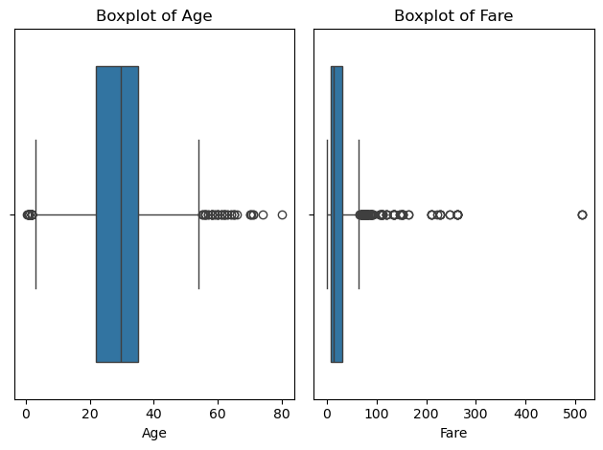
Outlier Detection & Treatment
Visualization
Outlier Treatment
Code Example
- Boxplots for Age & Fare show distribution and outliers
Use Z-score Method to deduct and trim Age outliers
- Use IQR method to detect and cap Fare outliers
Q1 = df['Fare'].quantile(0.25)
Q3 = df['Fare'].quantile(0.75)
IQR = Q3 - Q1
upper = Q3 + 1.5 * IQR
df['Fare'] = np.where(df['Fare'] > upper, upper, df['Fare'])

Slide 4

Encoding & Normalization
Text Cleaning
Strip space and standardize casing in categorical columns
Encoding
Map 'Sex' to numeric; one-hot encode 'Embarked'
Normalization
Scale 'Age' and 'Fare' using MinMaxScaler
Python Code
from sklearn.preprocessing import MinMaxScaler
df['Sex'] = df['Sex'].map({'male':0,'female':1})
df = pd.get_dummies(df, columns=['Embarked'])
scaler = MinMaxScaler()
df[['Age','Fare']] = scaler.fit_transform(df[['Age','Fare']])

Slide 5





Importance of Each Preprocessing Step
Cleaning
Feature Engineering
Encoding
Normalization
Removes or fills incomplete and irrelevant values to improve data quality. This ensures models are trained on complete and consistent information.
Converts categorical variables into numerical format so that machine learning models can understand and process them.
Scales numerical features to a common range to ensure all variables contribute equally to the model's performance.
Creates new useful features from existing ones to reveal hidden patterns. This improves model performance and prediction accuracy.

Slide 6

Final Dataset Summary
Summary
Missing values handled
Irrelevant columns removed
New features created
Outliers treated effectively
Variables encoded and normalized
Code Output
print(df.isnull().sum())
print(df.head())

Slide 7

Models Used:
Logistic Regression
Random Forest Classifier

Slide 8

Logistic Regression & Random Forest
Logistic Regression
Random Forest
A statistical model used for binary classification (Yes/No, 0/1).
Predicts probability using a sigmoid function.
Outputs values between 0 and 1.
A collection of many decision trees working together to make better predictions.
Works for both classification and regression.
Key Idea: Many weak models combine to form a strong model.

Slide 9

Evaluation Metrics
Accuracy
The percentage of correct predictions out of total predictions.
Example: If the model predicts 80 out of 100 passengers
correctly, accuracy is 80%.
Confusion Matrix
A table that shows how well the model distinguishes
between classes.
Example from model: [[92 13] [17 55]] → 92 = TN, 13 = FP, 17 = FN, 55 = TP
ROC AUC Score
(Receiver Operating Characteristic – Area Under Curve):
Measures the model’s ability to distinguish between
classes (0 and 1).
Example: Random Forest model had ROC AUC = 0.862 →
means it’s very good at separating survivors from non-survivors.

Slide 10
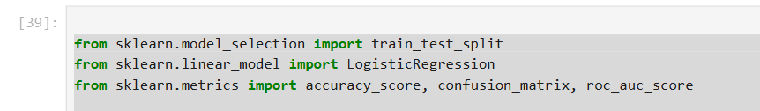
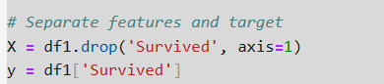
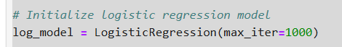
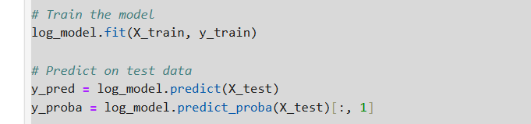
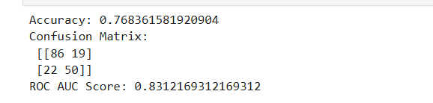
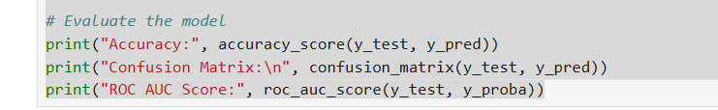
Target Variable: Survived (0 = No, 1 = Yes) Features Included:
Pclass, Sex, Age, SibSp, Parch, Fare, FamilySize, IsAlone, Embarked_C, Embarked_Q, Embarked_S
Train-Test Split: 80% Training, 20% Testing
Logistic Regression – Model Training Code Highlights:
Model: LogisticRegression(max_iter=1000)
Trained on training set
Made predictions on test set
Python Code Snippet

Slide 11
Parameters
n_estimators
max_depth
min_samples_split
min_samples_leaf
It means: the number of decision trees in the forest.
Example: If n_estimators = 200, the model will train 200 different decision trees.
It means: the minimum number of samples required to split an internal node.
Example: If min_samples_split = 5, a node must have at least 5 samples to be split into branches.
It means: the minimum number of samples required to be in a leaf node.
Example:If min_samples_leaf = 2, a leaf must have at least 2 samples.
It means: the maximum depth (levels) of each tree.
Example: max_depth = 10 means a tree can go 10 levels deep from root to leaf.

Slide 12
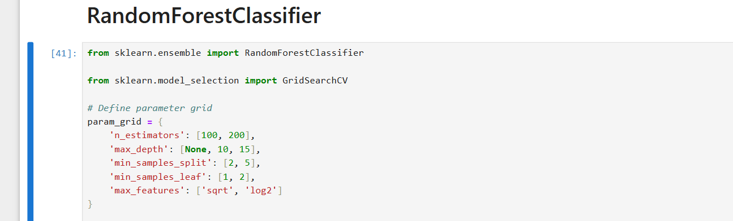
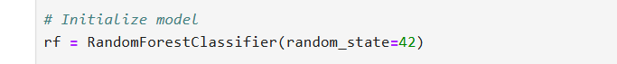
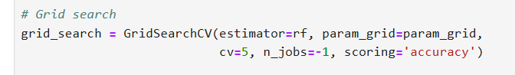
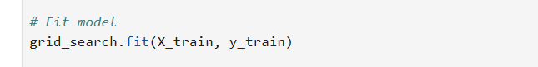
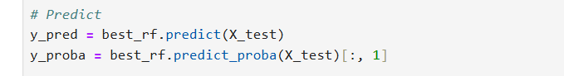
Python Code Snippet
What is this code doing overall?
Random Forest – Model Training
Used GridSearchCV for hyperparameter tuning
Parameter Grid: n_estimators, max_depth, min_samples_split, min_samples_leaf, max_features
rained using 5-fold cross-validation

Slide 13
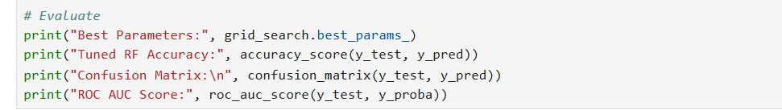
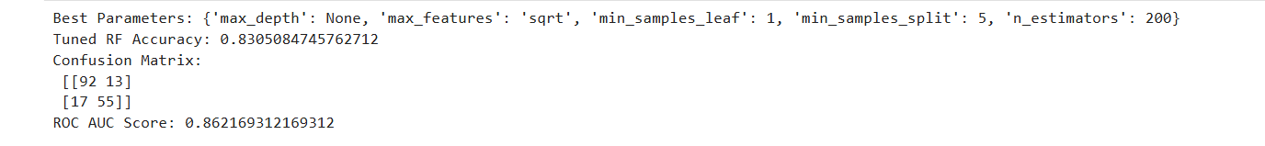

Slide 14
When to Use Logistic Regression & Random Forest
Logistic Regression
Random Forest
✅ Binary outcomes ✅ Linearly related features ✅ Small or medium datasets ✅ Easy to interpret results
Examples:
Will the Passenger Die? (Yes/No)
Is the email spam?
✅ Complex, large, or noisy data ✅ Non-linear relationships ✅ High accuracy needed ✅ Works with missing data
Examples:
Loan approval systems
House price prediction
Fraud detection

Slide 15
Summary
Logistic Regression: Best for simple, explainable binary problems.
Random Forest: Best for complex data with better accuracy.
Both models are powerful and used widely in business analytics.

